Slide 1
HW2: exome sequencing and complex disease
Jacquemin Jonathan de Bournonville Sébastien
Notes:
The subject of our hw2 is: exome sequencing and complex disease: practical aspects of rare variant association studies by ron do
This lecture will give a practical guidance in the design and analysis of exome sequencing studies

Slide 2
Table of contents
Introduction
Study design:
Sample selection
Sequencing strategy
Variant calling
Association analysis
Approaches for follow-up of promising signals
The role of functional assays in interpreting ESS
Conclusion

Slide 3
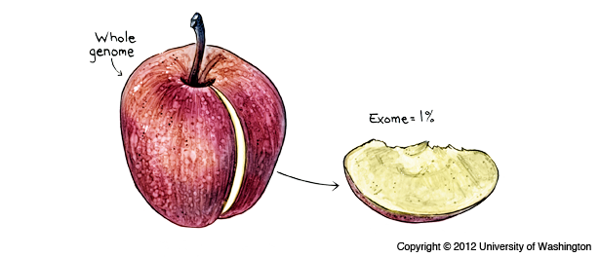
Introduction
Exome = only 1% of the entire genome

Slide 4
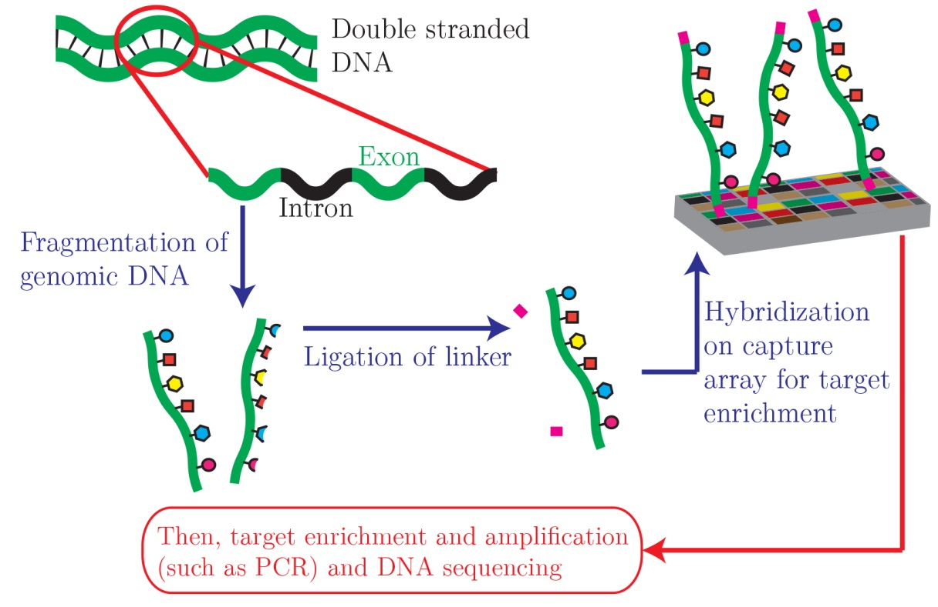
Introduction
Notes:
Double-stranded genomic DNA is fragmented by sonication. Linkers are then attached to the DNA fragments, which are then hybridized to a capture microarray designed to target only the exons.
Target exons are enriched and then amplified by ligation-mediated PCR. Amplified target DNA is then ready for high-throughput sequencing.

Slide 5
Study design: Sample selection
Objectives definition:
What kind of variants
What scale (survey range variations in individuals, find variants linked to specific trait)
Samples inventory with interesting traits
Focus on samples with extreme outcome
Quantitative traits → Extremes
Discrete traits → Unsuals
Sequencing related individuals?
Restricted geographic distribution
Founder populations
Notes:
Before anything the researchers have to clearly define their objectives at the outset. In order to do that they should know what kind of variants they want to find, at what scale they want to work, etc. They should also systematically inventory all samples in which the traits of interest might be examined.
Once these guiding questions are answered the researchers have to know which samples they want to sequence. Indeed the range of potentially informative sample exceeds the available sequencing budget. Thus they should usually focus on samples with an extreme outcome.
Although selecting individuals with extreme phenotypes or unusual (base on known risk factors) is important, many other study parameters have to be taken into account. For instance, sequencing related individuals (with great kinships) can be relevant and useful if a role for de novo mutation events is suspected.
Furthermore, one can expect that many rare variants will have a very restricted geographic distribution which involves a very careful matching of case and control ancestries to be performed. While the use of convenience control samples is relatively widespread in GWAS of common variants, an extreme care is needed in exome-sequencing studies as small differences in ancestry can potentially introduce false signals. However, once these concerns are overcome, convenience control samples are useful for increased sample sizes and power.
As rare variants can be geographically restricted, these interesting variants can also often be segregated in a population specific manner. That is why individuals from a wide variety on ancestries must be examined in order to perform an exome-sequencing study as complete as possible. For instance, founder populations can sometimes provide very useful and relevant individuals.

Slide 6
Study design: Sequencing strategy
High quality bases coverage
Reach >20x in ~90% of the protein coding sequences
Enrichment → Local variations → Aim for average depth of 60 to 80x
Light coverage of the rest of the genome
Notes:
It is common for the researchers to aim for coverage with high quality bases in order to reach a depth of 20x or greater in 80 to 95% of the protein coding sequences in each genome. This level of coverage should allow the researchers to identify the majority of protein coding variants with high specificity. However as the enrichment protocols efficiency induces great local variations this coverage level can be reached if the protein coding regions are sequenced at an average depth of 60 to 80x.
Most studies that target particular exome regions result in a light coverage of the rest of the genome (range of 0.2 to 2.0x on average). Though these reads are removed from the analyses and considered as “off-target”, Ron Do et al. think these reads could prove to be extremely useful. Indeed these off-target reads can be used to estimate the local or global ancestry of each sample or can be combined with a panel of reference haplotypes to estimate genotypes across the genome and could even facilitate detection of large structural variants.

Slide 7
Variant calling
Process raw sequences into high-quality genotypes:
Cleaning the DNA
Alignment of the short sequences reads to the reference genome
Removal of the duplicate reads
Quality metrics of each sample:

Slide 8
Variant calling
Process raw sequences into high-quality genotypes:
New quality metrics
Identification of variant sites + inspection

Slide 9
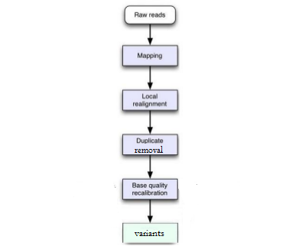
Variant calling

Slide 10
Variant calling
Drawback:
Many choices for these steps -> impacts the final result

Slide 11
Association analysis
A same variant alters different transcripts → focus on
Canonical transcript
Most deleterious transcript, etc.
Should always start with single variant association tests
In order to generate QQ plots and quality check
Population structure
Variants relevance
Groups variants that impact gene function
Notes:
A variant might alter the protein coding sequence for one transcript but not for other overlapping transcripts (these variants have multiple annotations). The researchers must then choose to focus only on the canonical transcripts for each gene, on the longest transcript in each gene or on the most functionally harmful prediction from all transcripts.
Every exome sequence analysis should start with single variant association tests. Even if these tests are not well powered for rare variants they provide a convenient opportunity to quality check (checking the population structure and variants relevance with genome wide QQ plots) the data.
A basic idea behind most rare variant association is to group variants that are likely to have an impact on the function of a specific gene and to compare the distribution of these variant groupings with the distribution of the trait of interest.

Slide 12
Association analysis
Consider two types of tests
Variable thresholds
Or variable cut-off frequencies
Analyses focused on homozygous individuals
P-values ~$5∗{10}^{−7}$
Generate summarizing QQ plots
Notes:
To perform a complete enough association analysis, the researchers should at least consider one test assuming all alleles impact the trait in the same direction and one test allowing alleles with opposite directions of effect in each gene. Furthermore they should use variable threshold implementations of these tests. If this last condition cannot be satisfied, it is recommended that a variety of cut-off frequencies should be considered (e.g. 0.05, 0.01 and 0.001). Finally another analysis focused on homozygous (or compound heterozygous) individuals for functionally deleterious variants in a gene might be a useful complement for data.
All these tests can be performed thanks to a number of packages that are under active development [6-8]. As no optimal statistical test is expected and given the multiplicity of these tests, permutation-based approaches should be used for evaluating statistical significance. When these permutation tests cannot be performed, it is advised to use P-values on the order of $5∗{10}^{−7}$ or less for burden test results from exome-sequencing studies. In this type of study, it is also highly recommended to generate QQ plots in order to summarize association results across the genome and ensure test statistics are well behaved.

Slide 13
Approaches for follow-up of promising signals
Goal: identify very rare variants
Different methods:
Data from other samples
Statistical imputation
Targeted sequencing
Notes:
Imputation : tries to predict missing SNPs based on the reference genotype

Slide 14
Conclusion
Forward genetics
Notes:
Exome can Evaluate the functionnal consequence of pathogenic mutations directly in humans
Forward genetics consist in understanding gene function by identifying patient harboring specific mutations and characterizing the physiologic and clinical consequences of these mutations

Slide 15
Conclusion
Challenges for future:
Apply it to complex and commom diseases
Methods to combine results from different studies
New protocols or statistical methods

Slide 16
Thank you for listening

Slide 17
References
http://www.geneticliteracyproject.org/2013/02/25/scientists-savage-each-other-over-junk-dna-study-while-journalists-mis-report-the-science/#.UqXNaeLZ2os
http://ueb.vhir.org/2012-06-18+Xavier+de+Pedro+Pipeline+for+Exome+Variant+Analysis
http://www.bioscience.org/2009/v14/af/3318/fulltext.php?bframe=figures.htm
https://www.my46.org/intro/whole-genome-and-exome-sequencing
http://en.wikipedia.org/wiki/Exome_sequencing

